Slide 1

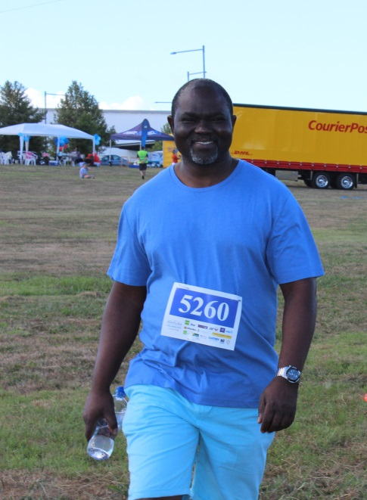
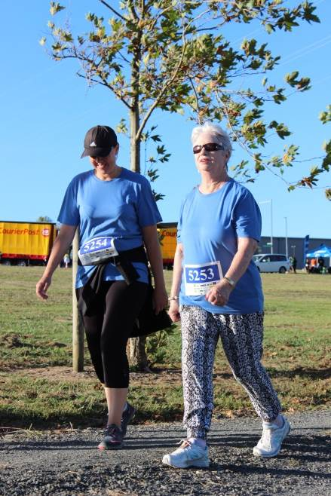
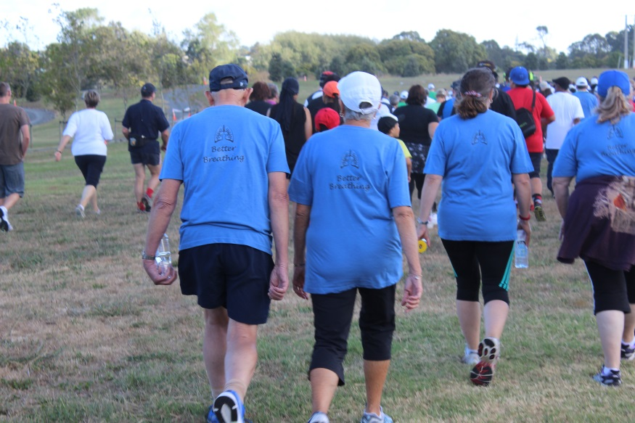
MAINTAINING
THE GAINS!
Notes:
<number>

Slide 2
OUTLINE
Why we should exercise and how to continue safely
How to over come barriers to exercise
Ideas to keep going after the programme

Slide 3
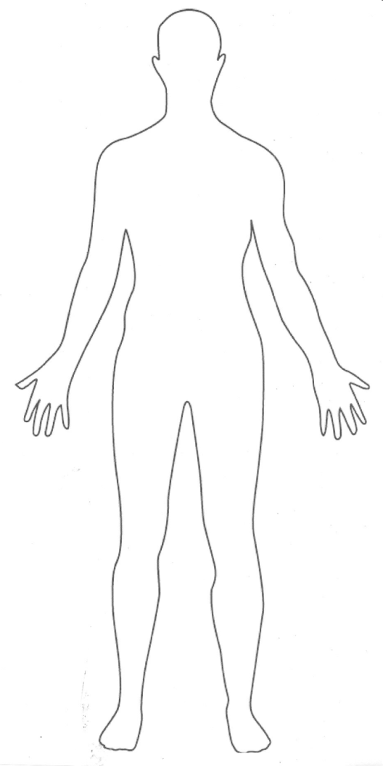
BENEFITS OF EXERCISE
Improved concentration
Improve mood
Reduce high blood pressure
Improves efficiency
of the heart
Reduce the risk of diabetes
Weight loss
Improve joint health
Improve bone density
Improve muscle strength
Improve balance
Improve circulation
and blood flow
Notes:
<number>
Top to toe

Slide 4
HOW TO EXERCISE SAFELY
  Something you enjoy
    Fits in with your life
    Group vs individual
  Exercise for about 30 minutes a day – if you need to divide up the time into shorter sessions and a mixture of cardiovascular and strength
  5 times a week
  Warm up and stretch before exercising
  Exercise at your own pace (Borg Scale 3-4)
  At the end of the session slow down gradually
  Do some stretches after your work out
  If you miss a few sessions re-start at a lower level than before
  If you get board with your current activity change to a different exercise
Notes:
<number>

Slide 5
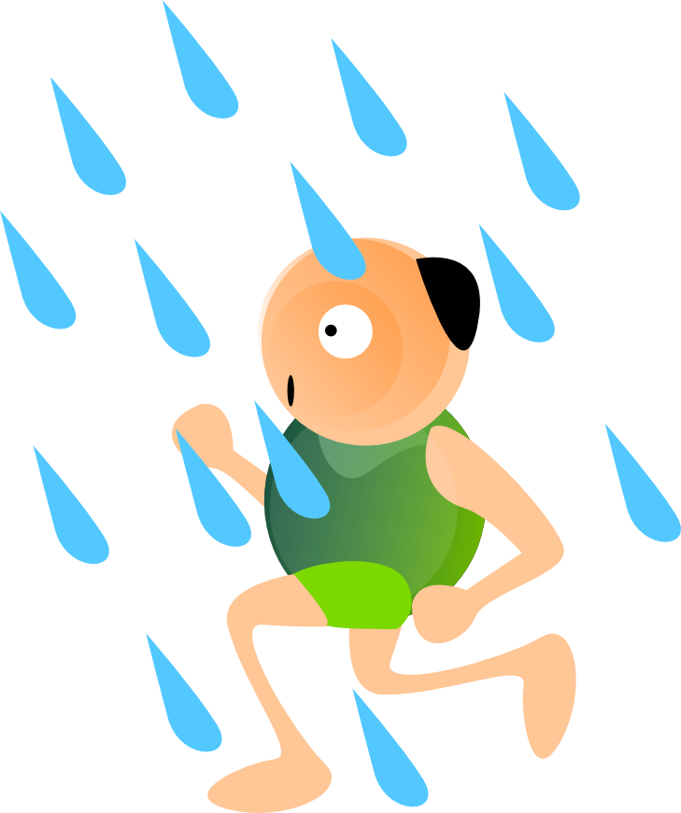
WHAT IS HARD ABOUT EXERCISE?
Motivation
Pain
Weather
Boring
Short of breath/ hard
Notes:
<number>

Slide 6

HOW TO OVERCOME BARRIERS
Motivation
  Music
  Group/ buddy
  Make an appointment
  Goals/ aims
  Keep track in a diary/ calendar
  Reward yourself
Pain
  Try water exercise
  Seated
Notes:
<number>

Slide 7
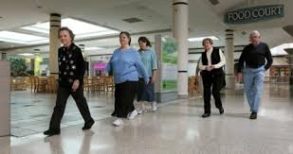
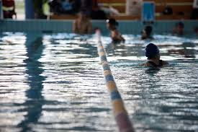
HOW TO OVERCOME BARRIERS
Weather
  Inside – mall, pool
Short of breath/ hard
  Pace your self
  Focus on your breathing
  Walk and talk
Notes:
<number>

Slide 8
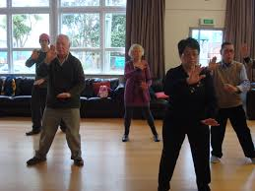
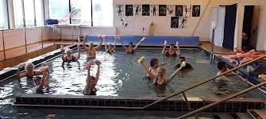
EXERCISE IDEAS
Walking
Home Exercise Programme
Green Prescription
  Gym
  Tai Chi
  Aqua aerobics
  Water walking
  Seated aerobics/ gentle exercise
Notes:
<number>

Slide 9
SUMMARY
Why we should exercise and how to continue safely
How to over come barriers to exercise
Ideas to keep going after the program
Notes:
<number>

